Slide 1
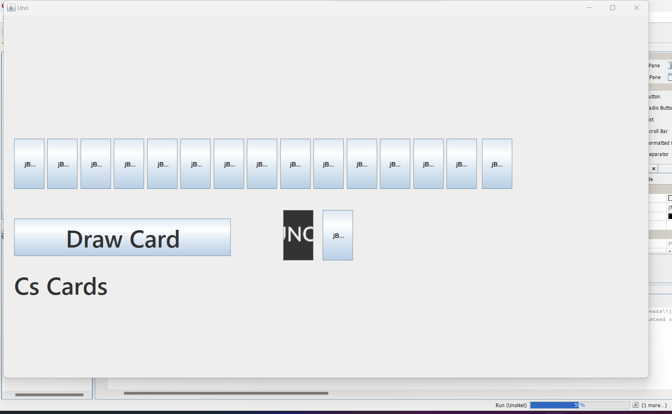
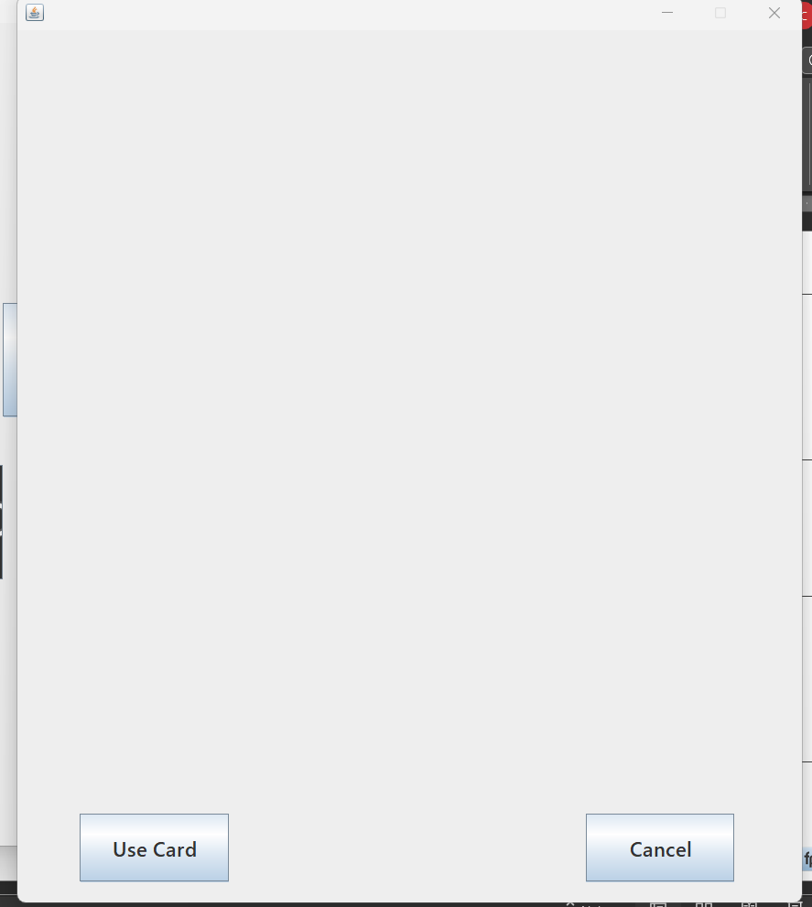
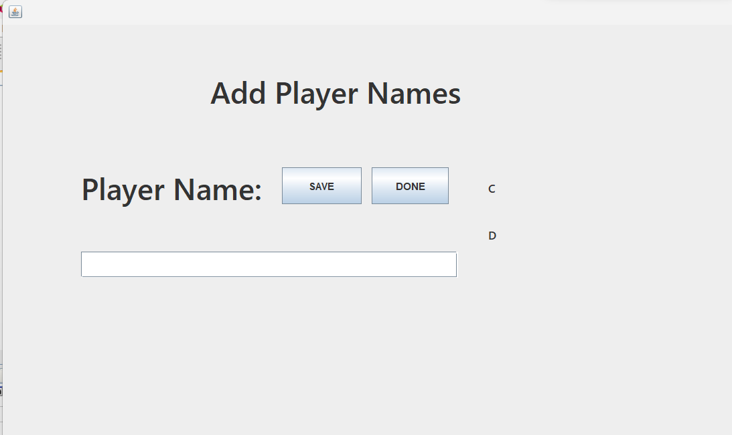
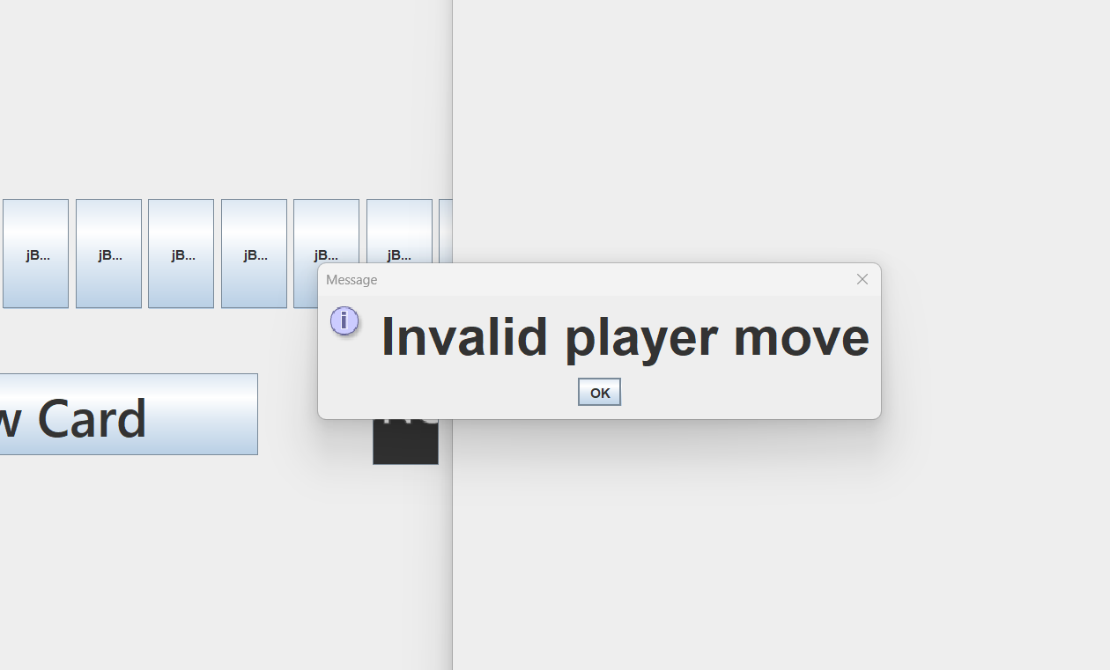
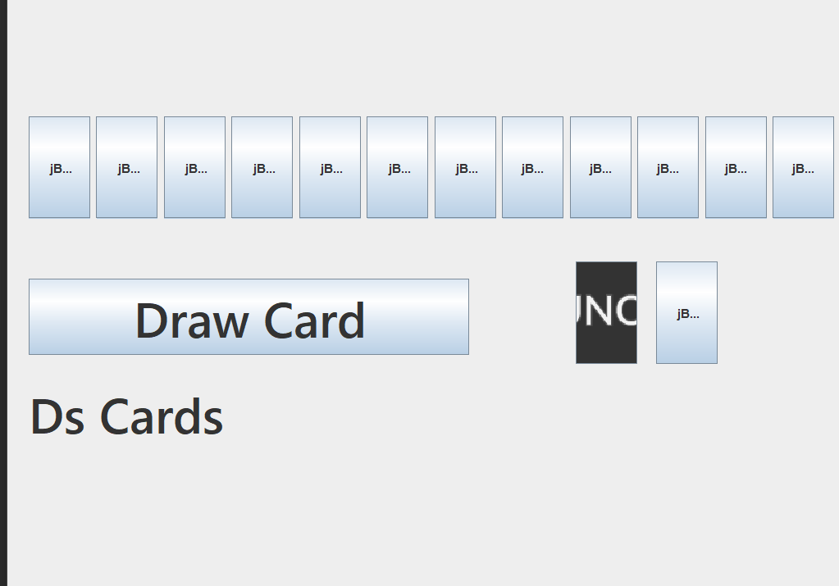

Simple Storyboard Template for PowerPoint
The user can then start the game and choose a card to play or to draw a card
The user picks the card and can chooser to use it or cancel it
The game starts with the interface asking the user to enter the names of the players
The users keep playing until the game is done
When the user plays the card it says if it was a valid card, invalid card, or what the action was if there was one
The game then moves to the next player up and continues to play the game

